Slide 1
Navigating the Application Development Framework Terrain

Slide 2
Presentation Outline
Part 1
  What are web frameworks?
  Why Use a Framework ?
Part 2
  Selecting a framework
    Business factors
Part 3
  Review of frameworks in use
    Struts
    WebWork
    Maverick
    Expresso
Part 4
  JavaServer Faces
Q&A
B
E
G
I
N
N
I
N
G

Slide 3
What is a Framework definition ?
The following are two commonly used definitions of a framework:
  "A framework is a partially complete software system that is intended to be instantiated. It defines the architecture for a family of systems and provides the basic building blocks to create them. It also defines the places were adaptations for specific functionality should be made." (Buschmann 1996)
  "A framework is a set of classes that embodies an abstract design for solutions to a family of related problems." (Johnson and Foote 1988)
Notes:
A framework is a set of prefabricated software building blocks that programmers can use, extend, or customize to suit their application.
It is an object oriented reuse mechanism that allows the developer to decompose an application into a set of interacting objects. It describes the interfaces implemented by the framework components, the flow of control between these components, and the contracts between the components and the system. In this way the framework is a reusable design.
The standard interfaces and interactions make it possible to mix and match existing components and create a wide variety of systems from a core set of components. With frameworks, developers don't have to start from scratch each time they build an application.
Application frameworks are large often very complex tools that many developers do not yet fully understand.
This means they cannot take advantage of the substantial benefits such a technology can bring to their development project - they often are re-inventing the wheel repeatedly.
As the market for web applications begins its second wave, this session provides the critical information for developers to make the transition into componentized framework-based development.
Basically, a framework is a semi-complete application. It's different from a class library in that control is inverted. When you use class libraries, the main control flow is in the application code that makes calls to methods in the class library. In the case of a framework, the main control flow is in the framework code that makes calls to the application code. This inversion of control is typically referred to as the Hollywood Principle: "Don't call us. We'll call you."
The developer builds a complete application by inheriting from and instantiating components in the framework.

Slide 4
Types of Frameworks (cont)
Template Engines
i.e. FreeMarker, Velocity, WebMacro
Event Model Approach
i.e. Barracuda, JPublish
XML Publishing Frameworks
i.e. Cocoon
MVC 2 based Presentation Frameworks,
i.e. Struts, Maverick, Webwork
MVC2 based Architectural Frameworks - Component Orientated Approach,
i.e. Avalon?, Expresso, Tapestry, Turbine
Vertical Frameworks,
i.e Oracle Business Framework
Notes:
Architectural frameworks are a feature superset of presentation frameworks.

Slide 5
Focus of Session is MVC 2 Based
Model
Service-to-Worker Pattern
Encapsulates application state
Responds to state queries
Exposes application functionality
Value Objects, DAOs, Entity Beans
Update
Status
State
Request
Change
Notification
View
Dispatcher View Pattern
Renders the models
Requests updates from models
Sends user gestures to controller
Allows controller to select view
JSPs, Tag Libs, Templates etc
Controller
Front Controller Pattern
Defines application behavior
Centralized request handling
and dispatch logic
Selects view for response
Action Mappings, components,
beans, jsp engine, proxies
User
Action
Determine
View
View Helper Pattern
Intercepting Filter Pattern
Method Invocations
Events
Notes:
Focus of session is mvc2 based Frameworks and mvc2 based Architectural Frameworks
Application Development Frameworks supporting the MVC "model 2" architecture as recommended by Sun Microsystems
Not a data model but a service model
Accessed through a request/response mechanism
View unaware
transactional
Other frameworks while not covered here are often complementary and may also benefit your development, i.e. Velocity, Cocoon.

Slide 6
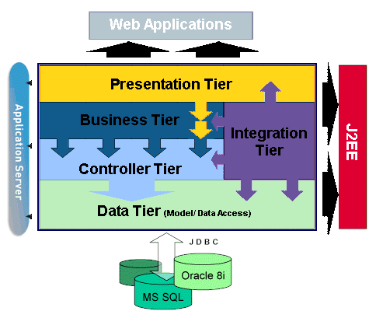
MVC2 Based Frameworks
Presentation Frameworks focus on the Controller tier and integrates with technologies to provide the Model and the View.
An architectural framework is a superset of functionality comprising a substantial collection of components.
Notes:
MVC functionality is captured in a framework that is reused by different applications.
MVC2 implementations can be “fitted” seamlessly into well designed architectural frameworks.
MVC2 oriented architectures are “abstract” in implementation, “aggregated” by design, “isolated” in nature.
Architectural frameworks are “comprehensive” in approach.
Open, best practices approach that enables architecture services to be easily extended and modified
Architectural frameworks are grown and evolved based on the needs of the applications used in the enterprise.
Such infrastructures are “evolving” into complex architectures in the web services world.

Slide 7
What do these Frameworks do ?
Provide Consistent Programming Model
Structure to web application development
  Separation of MVC concerns, and infrastructure to plumb these together.
Generic services that are needed by most applications
  such as security, logging, configuration, persistence, caching, etc.
Tools and methods that simplify and accelerate web development.
  Event handling, job processing, data exchange and monitoring capabilities.
  Automated testing
Notes:
Most enterprise applications have a great deal in common - no matter what the application does or who uses it. Every enterprise application requires services such …..
In most projects, each service is either developed "from scratch", or pieced together from different vendor offerings. This process is repeated project after project, with little or no reuse even though the same basic needs do not change between applications. Clearly if these common services could be pulled into a core framework that could be tested once and reused across many projects, it would be a huge benefit to nearly every enterprise web application project not to mention cutting project costs and improve software quality in one swoop.
A framework is a set of prefabricated software building blocks that programmers can use, extend, or customize to suit their application.
It is an object oriented reuse mechanism that allows the developer to decompose an application into a set of interacting objects. It describes the interfaces implemented by the framework components, the flow of control between these components, and the contracts between the components and the system. In this way the framework is a reusable design.
The standard interfaces and interactions make it possible to mix and match existing components and create a wide variety of systems from a core set of components. With frameworks, developers don't have to start from scratch each time they build an application.
Application frameworks are large often very complex tools that many developers do not yet fully understand.
This means they cannot take advantage of the substantial benefits such a technology can bring to their development project - they often are re-inventing the wheel repeatedly.
As the market for web applications begins its second wave, this session provides the critical information for developers to make the transition into componentized framework-based development.

Slide 8
Why Use Frameworks ?
Solving Challenges Through Consistent Architecture
So you don’t spend a large portion of your time writing "plumbing" code for common services, rather than on business logic specific to the application.
Common services such as:
  Object Caching
  Administrative screens for security, database connection pool allocations, etc.
  Object /Relational Database mapping capabilities
  Email notification and Email Connectivity
  Event notification
  Process scheduling
  User security
  Database data import/export in different media
  Dynamic content generation
  Configuration and Setup Values
  UI-independant Application Logic development

Slide 9
How Do Frameworks
Benefit Projects?
Good ROI – don’t have to build from scratch
Faster and improved rapid development.
Improved software quality.
Reduced risk and reduced cost of project deployment.
Leverages open and shared standards.
Standard Patterns and architecture guidance.
Notes:
Doesn't reinvent the wheel.
Reduced risk and reduced cost of project deployment by
dramatically lowering the amount of low-level coding.
Choosing a mature OSS framework
Enhanced opportunities with a repository of reusable application code.
Reuse in frameworks benefits the ability of end-user applications to stay current with technology changes.
Reduces code maintenance
Better quality
easier to unit test the modular design of a framework based application.
11 Patterns - In addition to what has been discussed, framework encourage better design in the code by providing an example to guide them to more effectively utilize the underlying technology. Applications tend to be more maintainable and reusable. The experience level of the developer required to build an application is greatly reduced.
12 Extending functionality: Frameworks provide interfaces for extending functionality at a high level. Applications can be developed by using the framework as a starting point and developers then write small amounts of code to modify or extend the framework's behavior, These extensions can be added without sacrificing compatibility and interoperability because interfaces are well defined.
14. Interoperability: the well defined interfaces of the framework allow other applications that use the core set of services to be interfaced.
Shorter development schedule/shorter time to market: Development projects no longer have to solve the many problems related to Web applications. They simply reuse the code provided by the framework. Project developers don't have to design, develop, or test these framework services; they take them for granted.
Reduced development risk: With a complex programming model like J2EE, the risk of project failure is high to begin with. An application development framework can significantly reduce the risk by serving as a reliable proven base.
Consistent application architectures: Using a framework results in all applications having similar application architectures, which makes them easier to learn, support, and maintain.
The benefits come down to design savings, code savings, and test savings.

Slide 10
How are Frameworks Evolving?
Component decoupling, i.e. ability to use other persistence mechanisms
Pressure on being standards based, components swapped
More patterns defined. More patterns based.
UIs will improve. More emphasis on graphical wizards
Tighter integration to IDE environments that do more for you.
Notes:
Market maturing:
- products maturing
Many new products come to market
In fallout Vertical frameworks less likely to survive, than horizontal frameworks.
Standards
Functions may become redundant as components are swapped with accepted or defacto standards, i.e. Struts MVC.
Component-based design brings a further level of refinement to software architecture. Components are being written based on a particular component standard (COM, JavaBeans, Enterprise JavaBeans, Corba, etc.) and should be pluggable by a tool and/or application. Components not only encapsulate a unit of functionality (like a class in object-oriented design), but also have a discoverable structure/interface used by other components, applications, development tools or component servers.
Typically, each component is a reusable, independent unit that can be combined with other components. In many cases, writing an application entails assembling a wall from several ready-made component bricks and a few of your own. This assembly process can be sophisticated if you need to tune the level of thickness of each layer, optimize performance and resources, and integrate components from different vendors.

Slide 11
PART 2:
OSS Framework Products: Business Factors* Reviewed
* Source: see http://www.mvc2frameworks.org

Slide 12
Desirable in Selecting an Framework
High Activity - in development, user groups, visibility etc.
Large User Community and Support Group.
Large Developer Community.
Integration with other open source projects: i.e. Bouncycastle, Cactus, Log4J, JUnit, Xerces, Xalan and Struts
Strong leadership, Strong leadership, ditto.
[Depends largely on your problem space]

Slide 13
Frameworks Reviewed
Open-source, MVC II, popular, commercially-adequate-licensed frameworks:
  MVC2 Presentation Frameworks.
    Struts http://jakarta.apache.org/struts/index.html
    Webwork http://www.opensymphony.com/webwork
    Maverick http://mav.sourceforge.net
  MVC2 Architectural Frameworks.
    Expresso http://www.jcorporate.com

Slide 14
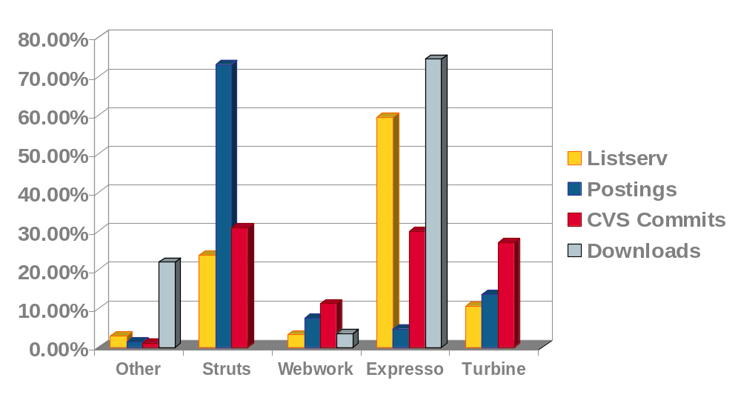
Popularity Index
“Popularity Index”
A comparison of the community factors
Average Monthly Nov ’02- April ‘03
S
U
M
M
A
R
Y
* Source: see http://www.mvc2frameworks.org
Notes:
Add metric for listserv size

Slide 15
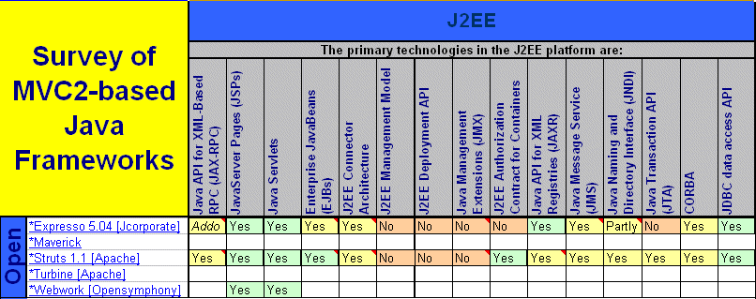
J2EE Matrix

Slide 16
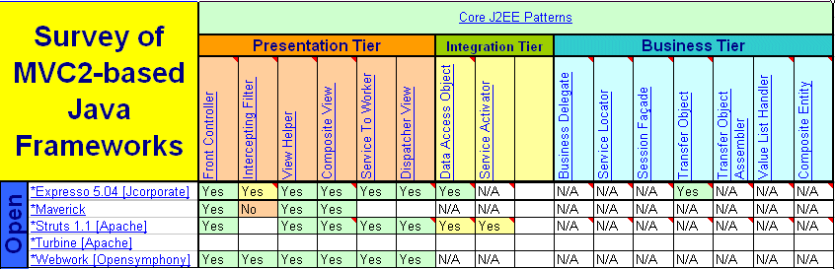
Patterns Matrix
Notes:
Patterns -- Patterns represent recurring solutions to software development problems within a particular context.
Patterns and frameworks both facilitate reuse by capturing successful software development strategies.
The primary difference is that frameworks focus on reuse of concrete designs, algorithms, and implementations
In contrast, patterns focus on reuse of abstract designs and software micro-architectures.
Frameworks can be viewed as a concrete reification of families of design patterns that are targeted for a particular application-domain.
Likewise, design patterns can be viewed as more abstract micro-architectural elements of frameworks that document and motivate the semantics of frameworks in an effective way.
When patterns are used to structure and document frameworks, nearly every class in the framework plays a well-defined role and collaborates effectively with other classes in the framework.

Slide 17
PART 3:
OSS Presentation Frameworks: Technical* Review
* Source: see http://www.mvc2frameworks.org

Slide 18
Framework Components Identified
PRESENTATION TIER [VIEW}
XML
Processing
Layout
Toolkit
Template
Languages
Personal-
ization
International
-ization
Data-Driven
UI
DATA TIER [MODEL]
Monitoring
Logging
Cluster
Support
Job
Scheduling
Query
Connection
Pooling
Data
Access
DBO
Caching
O/R
Mapping
Row-level
Security
Supports JDBC
Transactions
Supports JTA
Transactions
BUSINESS TIER
CONTROLLER
Notification
Alerts
Security, Users
Group Mgmt
Workflow
Event-
Driven
Prevents
Resubmit
Workspaces
INTEGRATION TIER
Web
Services
IDE
Integration
EJB
Integration
LDAP
Support
JMS
Support
JNDI
Support
Notes:
Components -- Components are self-contained instances of abstract data types (ADTs) that can be plugged together to form complete applications. Common examples of components include VBX controls and CORBA Object Services. In terms of OO design, a component is a blackbox that defines a cohesive set of operations, which can be reused based solely upon knowledge of the syntax and semantics of its interface. Compared with frameworks, components are less tightly coupled and can support binary-level reuse. For example, applications can reuse components without having to subclass from existing base classes. The relationship between frameworks and components is highly synergistic, with neither subordinate to the other. Frameworks can be used to develop components, whereby the component interface provides a Facade for the internal class structure of the framework. Likewise, components can be used as pluggable strategies in blackbox frameworks. In general, frameworks are often used to simplify the development of infrastructure and middleware software, whereas components are often used to simplify the development of end-user application software. Naturally, components are also effective for developing infrastructure and middleware, as well.
"model" section will distinguishe full-featured frameworks from lighter-weight frameworks,

Slide 19
Struts Reviewed
An MVC framework for building Web Applications.
Latest production release – 1.0.2 (1.1 is at rc1)
15+ contributors.
Related products : jakarta 'siblings', Webwork, Maverick

Slide 20
Overview
Most popular—several books, huge community
Controller Servlet as dispatcher
XML configuration
Supports many view technologies: JSP, Velocity, XSLT, etc.
Custom tag libraries for JSP
Tons of plug-ins and add-on goodies
S
T
R
U
T
S

Slide 21
Struts Component Diagram
PRESENTATION TIER [VIEW}
XML
Processing
Layout
Toolkit
Template
Languages
Personal-
ization
International
-ization
Data-Driven
UI
DATA TIER [MODEL]
Monitoring
Logging
Cluster
Support
Job
Scheduling
Query
Connection
Pooling
Data
Access
DBO
Caching
O/R
Mapping
Row-level
Security
Supports JDBC
Transactions
Supports JTA
Transactions
BUSINESS TIER
CONTROLLER
Notification
Alerts
Security, Users
Group Mgmt
Workflow
Event-
Driven
Prevent
Resubmit
Workspaces
INTEGRATION TIER
Web
Services
IDE
Integration
EJB
Integration
LDAP
Support
JMS
Support
JNDI
Support
Notes:
Components -- Components are self-contained instances of abstract data types (ADTs) that can be plugged together to form complete applications. Common examples of components include VBX controls and CORBA Object Services. In terms of OO design, a component is a blackbox that defines a cohesive set of operations, which can be reused based solely upon knowledge of the syntax and semantics of its interface. Compared with frameworks, components are less tightly coupled and can support binary-level reuse. For example, applications can reuse components without having to subclass from existing base classes. The relationship between frameworks and components is highly synergistic, with neither subordinate to the other. Frameworks can be used to develop components, whereby the component interface provides a Facade for the internal class structure of the framework. Likewise, components can be used as pluggable strategies in blackbox frameworks. In general, frameworks are often used to simplify the development of infrastructure and middleware software, whereas components are often used to simplify the development of end-user application software. Naturally, components are also effective for developing infrastructure and middleware, as well.
"model" section will distinguishe full-featured frameworks from lighter-weight frameworks,

Slide 22
Critique
Positives
Expertise of large community, books, docs.
Rich tag libraries
Defacto Standard
VERY easy to find skilled Struts resources in market.
S
T
R
U
T
S
Negatives
Extending is not so easily done due to lack of interfaces.
Large API/large footprint.
Medium learning curve

Slide 23
Webwork Reviewed
An MVC framework for building Web Applications.
Latest production release – 1.3.0
21+ contributors.
Related products : Struts, Maverick

Slide 24
Overview
MVC engine for J2EE, requires at least Servlet 2.3
Actions are JavaBeans, enabling reflection-based usage
"Compared with Struts, WebWork is smaller, simpler"
Part of large framework, OpenSymphony
Supports many view technologies: JSP, Velocity, XSLT, Jasper, etc.
Custom tag library
W
E
B
W
O
R
K

Slide 25
Feature Highlights
Version 2 offers Inversion-of-control pattern, enabling the framework to supply references to required resources without explicit requests from the client component
Attention to using interfaces for loose coupling
  No abstract classes like Struts!
Separation from Servlet Context.
  Actions can be used in any context
    e.g. Actions can be sent over RMI, or JMS
Tag library offers scripting/expression language
W
E
B
W
O
R
K

Slide 26
Inversion-of-Control: What?
IoC takes the role of managing components from your business logic, and gives it to a container.
The container manages the component lifecycle
Typically, you configure the components (e.g. in an XML file)
EJB is IoC for a few services
  transactions, persistence, security
Jakarta Avalon is an IoC framework
W
E
B
W
O
R
K

Slide 27
Inversion-of-Control: Why?
Promotes simplicity and decoupling
Components describe themselves
Dependencies are discovered automatically
Leads to good interface/impl separation
Easy to Unit test
  Can run from outside of “container”
  Easy to use Mock Objects
W
E
B
W
O
R
K

Slide 28
Inversion-of-Control: How?
Lets create a Banking service that is used by an action:
BankingAware.java:
public interface BankingAware {
public void setBanking(Banking bank);
}
Banking.java:
public interface Banking {
public int withdraw(Account act, Money amt);
public int deposit(Account act, Money amt);
…
}
W
E
B
W
O
R
K

Slide 29
Inversion-of-Control: How? … 2
WithdrawMoney.java:
public class WithdrawMoney implements Action, BankingAware {
public void setBanking(Banking bank) { this.bankService = bank; }
public String execute() throws Exception {
if (bank == null) return ERROR;
bank.withdraw(getAccount(), getAmount());
}
}
W
E
B
W
O
R
K

Slide 30
Inversion-of-Control: How? … 3
We need to configure the banking service:
<components>
<component>
<scope>application</scope>
<class>com.foo.BankingService</class>
<enabler>com.foo.BankingAware</enabler>
</component>
</componments>
W
E
B
W
O
R
K

Slide 31
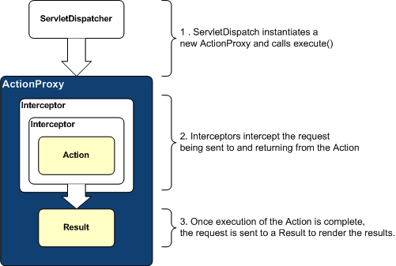
Interceptors
W
E
B
W
O
R
K

Slide 32
Critique
Positives
Clean design, separation from Servlet Context.
No action/form bean classes
  Simply use model-drive actions and YOUR model
No need to make actions thread safe
“Plays well with others”
  Multiple views
  No tight coupling
Interceptors
Negatives
Properties files not XML (in X2)
JSTL? (in X2)
W
E
B
W
O
R
K

Slide 33
Future directions: Version 2
WebWork2 enables a flexible system of "interceptors" for pre- and post-processing of a request
Project split into two parts:
  XWork: Generic command framework
  WebWork2: Integration with the “web”
Built in type conversion and action property validation using Object-Graph Navigation Language (OGNL), an expression language for getting and setting properties of Java objects
Validation framework based on runtime attributes and a validation interceptor
W
E
B
W
O
R
K

Slide 34
OGNL Examples
Here are some examples of OGNL (http://www.ognl.org/)
OGNL | RESULT
pet.name | getPet().getName()
pet.toString() | getPet().toString()
pet.categories[0] | First element of Categories collection
name in { “fred”,null } | True is name is null or “fred”
categories.{name} | Calls getName() on each category in the collection, returning a new collection
W
E
B
W
O
R
K

Slide 35
Maverick
A servlet based framework for developing web applications.
13,545 downloads.
Dev Team: 4 Members
Latest stable version – 2.2 (Jun 2003 release)
Related products : WebWork2.

Slide 36
Overview
Very light-weight presentation framework.
Uses JSP, Velocity and XSLT on the presentation tier.
Use of shunting for internationalization
Multiple controllers at disposal.
Tile-ish ability but much easier.
Also comes in PHP, .Net and metallic red.
M
A
V
E
R
I
C
K

Slide 37
Feature Highlights
Very simple to use for simple solutions
Rock solid code.
Domify is a quick and dirty XSLT solution.
No tag lib… and that can be a good thing.
Multiple controllers allow a different “tweak” on MVC
  Controller-as-model
  “Struts-ish” controller
M
A
V
E
R
I
C
K
T
U
R
B
I
N
E

Slide 38
Critique
Positives
Very easy to use framework.
Easily extended.
Excellent community.
Good docs and examples
Negatives
Too light-weight
Internationalization strange.
M
A
V
E
R
I
C
K
T
U
R
B
I
N
E

Slide 39
PART 4:
OSS Architectural Frameworks: Technical* Review
* Source: see http://www.mvc2frameworks.org

Slide 40
Expresso Reviewed
A server side framework providing components for creating web-based applications.
135,000+ downloads.
40 Contributors.
Latest stable version – 5.1
Related products : Turbine, Altoweb, RealMethod, SunOne Jato, Wakesoft

Slide 41
Overview
Extensive architectural framework for server side development.
Provides several pieces of the architecture - MVC, O/R mapping, Configuration, Security, Caching etc.
Fits both J2EE and non-J2EE environments.
The presentation layer combines the struts framework with a unique state machine type of controller
Supports different UIs - JSPs, XSL, etc.
Provides a web based user, security and configuration management for applications and framework
E
X
P
R
E
S
S
O

Slide 42
Feature Highlights
Security
  Several security levels and functions:
    User management and login Security
    Application Security.
    Database Object Security.
    Job Control, Controller Security.
Caching
  Can be use to cache any type of objects
  Commonly used objects like config values and security data are automatically cached
  Caching of Database objects can be configured
  Can use CacheManager to cache any custom object

Slide 43
Feature Highlights - Database Objects
Provide database independent OR Mapping.
Methods to add, update, delete, search and retrieve.
No need to code SQL in Application.
Support for Virtual Fields, Referential Integrity, Value Checks, Sequences.
DBMaint Servlet provides database-maintenance functionality for any database Object.
Schema objects could be used to automatically generate database tables
E
X
P
R
E
S
S
O

Slide 44
Expresso Component Diagram
PRESENTATION TIER [VIEW}
XML
Processing
Layout
Toolkit
Template
Languages
Personal-
ization
International
-ization
Data-Driven
UI
DATA TIER [MODEL]
Monitoring
Logging
Cluster
Support
Job
Scheduling
Query
Connection
Pooling
Data
Access
DBO
Caching
O/R
Mapping
Row-level
Security
Supports JDBC
Transactions
Supports JTA
Transactions
E
X
P
R
E
S
S
O
BUSINESS TIER
CONTROLLER
Notification
Alerts
Security, Users
Group Mgmt
Workflow
Event-
Driven
Prevents
Resubmit
Workspaces
INTEGRATION TIER
Web
Services
IDE
Integration
EJB
Integration
LDAP
Support
JMS
Support
JNDI
Support
Notes:
Components -- Components are self-contained instances of abstract data types (ADTs) that can be plugged together to form complete applications. Common examples of components include VBX controls and CORBA Object Services. In terms of OO design, a component is a blackbox that defines a cohesive set of operations, which can be reused based solely upon knowledge of the syntax and semantics of its interface. Compared with frameworks, components are less tightly coupled and can support binary-level reuse. For example, applications can reuse components without having to subclass from existing base classes. The relationship between frameworks and components is highly synergistic, with neither subordinate to the other. Frameworks can be used to develop components, whereby the component interface provides a Facade for the internal class structure of the framework. Likewise, components can be used as pluggable strategies in blackbox frameworks. In general, frameworks are often used to simplify the development of infrastructure and middleware software, whereas components are often used to simplify the development of end-user application software. Naturally, components are also effective for developing infrastructure and middleware, as well.
"model" section will distinguishe full-featured frameworks from lighter-weight frameworks,

Slide 45
Critique
Positives
Comprehensive – many components
Powerful Finite state machine model for maintaining application states and transitions, coupled with Struts MVC
Powerful, rich O/R mapping and management framework.
E
X
P
R
E
S
S
O
Negatives
Dependency on DBObjects
Large API, steep learning curve.
So big difficult to keep up with the smaller guys.

Slide 46
JavaServer Faces
A server side user interface component framework for Java technology-based web applications

Slide 47
Overview
Server side component model
Tool friendly
Client device/protocol neutral
Usable with/without JSP
Extensible UI components
Flexible rendering model
Event handling model
Validation framework
Page navigation
F
A
C
E
S

Slide 48
Components
UIComponent/UIComponentBase
  JavaBean base class
Usable Subclasses
  UICommand, UIForm, UIGraphic, UIInput
  UISelectBoolean, UISelectMany, UISelectOne
  and more…
Value references access bean properties
  e.g. “order.city”
F
A
C
E
S

Slide 49
Events / Listeners
Follows JavaBeans patterns
Standard events and listeners
  ActionEvent
    Fired when UICommand activated by user
  ValueChangedEvent
    Fired when UIInput value was changed
F
A
C
E
S

Slide 50
Validators
Perform validation on UIInput values
  Register one or more per component
  Queue up one or more error messages
  Implementations for common cases
    String length
    Email
    State
    Credit Card
    etc
F
A
C
E
S

Slide 51
Navigation
Pluggable NavigationHandler
Default rules configured in faces-config.xml
<navigation-rule>
<from-tree-id>*</from-tree-id>
<navigation-case>
<from-action-ref>searchHandler.go</from-action-ref>
<from-outcome>success</from-outcome>
<to-tree-id>/searchResults.jsp</to-tree-id>
</navigation-case>
</navigation-rule>
F
A
C
E
S

Slide 52
RenderKits
Pluggable RenderKits
HTML RenderKit is given
RenderKits for WML, XML, SVG, etc being created
You can create your own render kit
F
A
C
E
S

Slide 53
Example JSP using Faces
<f:use_faces>
<f:form formName=“logonForm”>
<h:panel_grid columns=“2”>
<h:output_text value=“Username:”/>
<h:input_text id=“username” length=“16” valueRef=“logonBean.username”/>
<h:output_text value=“Password:”/>
<h:input_text id=“password” length=“16” valueRef=“logonBean.password”/>
<h:command_button type=“submit” label=“Log on” actionRef=“logonBean.logon”/>
</h:panel_grid>
</f:form>
</f:use_faces>
F
A
C
E
S

Slide 54
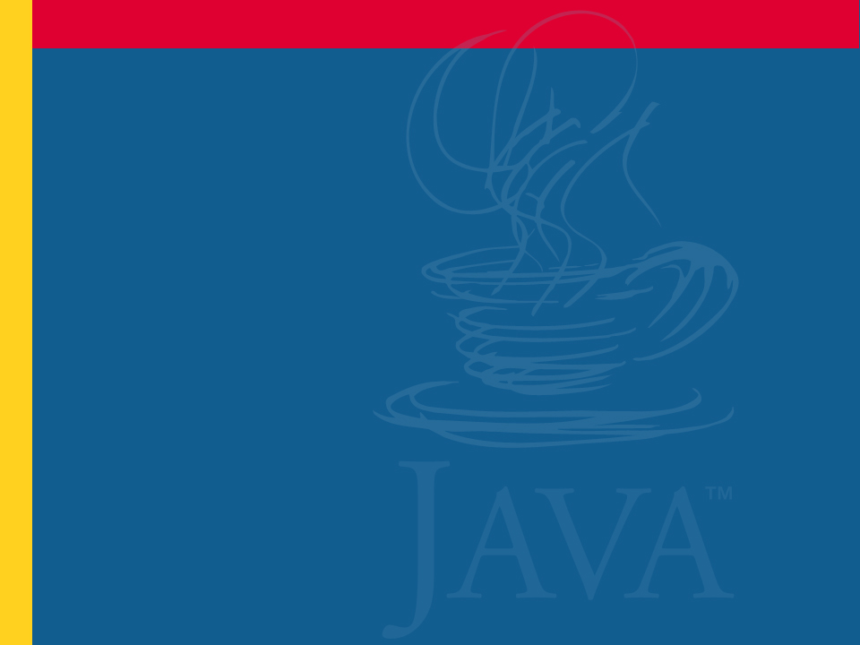
Q&A

